Slide 1
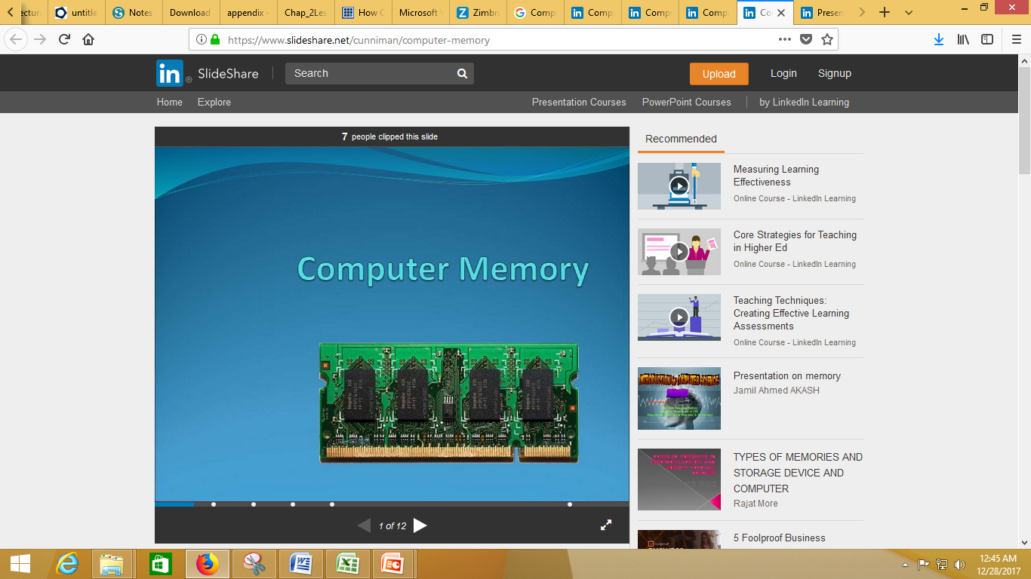

Slide 2
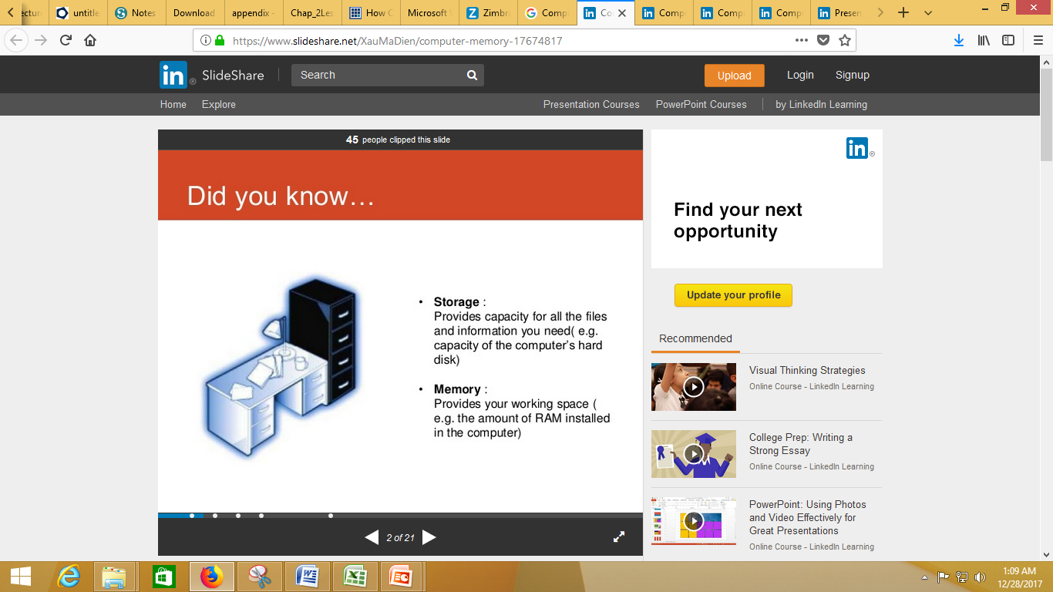

Slide 3
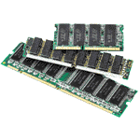
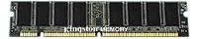
Computer memory is extremely important to computer operation.
Files and programs are loaded into memory from external media like
fixed disks (hard drives) and removable disks (floppies tapes).
Memory can be built right into a system board, but it is more typically
attached to the system board in the form of a chip or module. Inside
these chips are microscopic digital switches which are used to
represent binary data.
A good example of this is when the CPU loads an application program
- such as a word processing or page layout program - into memory,
thereby allowing the application program to work as quickly and
efficiently as possible. In practical terms, having the program loaded
into memory means that you can get work done more quickly with
less time spent waiting for the computer to perform tasks.

Slide 4
The process begins when you enter a command from your keyboard. The CPU interprets the command and instructs the hard drive to load the command or program into memory. Once the data is loaded into memory, the CPU is able to access it much more quickly than if it had to retrieve it from the hard drive.
This process of putting things the CPU needs in a place where it can get at them more quickly is similar to placing various electronic files and documents you're using on the computer into a single file folder or directory. By doing so, you keep all the files you need handy and avoid searching in several places every time you need them.
In general the more RAM a computer has the faster the computer operates. Why? RAM is where all the information is kept just before the computer needs to use it.

Slide 5
Think of it this way. During a conversation a person can speak without interruption if everything being talked about is in his or her memory. However, if a person does not have enough memory and has to look something up during the course of the conversation, in a book or newspaper, then the conversation stops until the needed information is found.
Computers are very similar; they can continue processing without interruption as long as all needed information is in memory (RAM). When that is not the case, the computer stops, retrieves the needed information from storage (i.e. Hard drive, CD, disk) and places it into memory and then continues processing. The more interruptions the computer receives to retrieve information the slower the computer. The more memory a computer has, the fewer interruptions and the faster the computer operates. More memory equates to more speed.

Slide 6


Slide 7
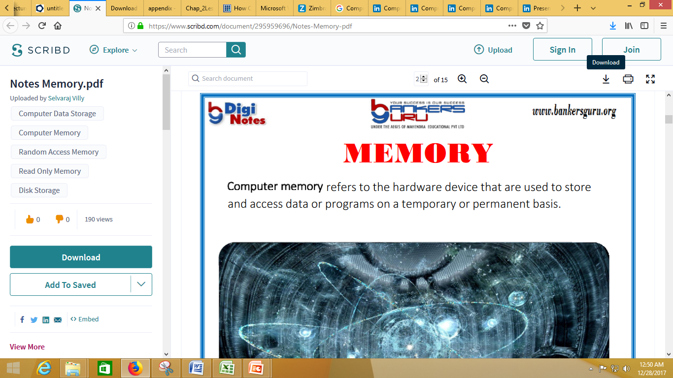
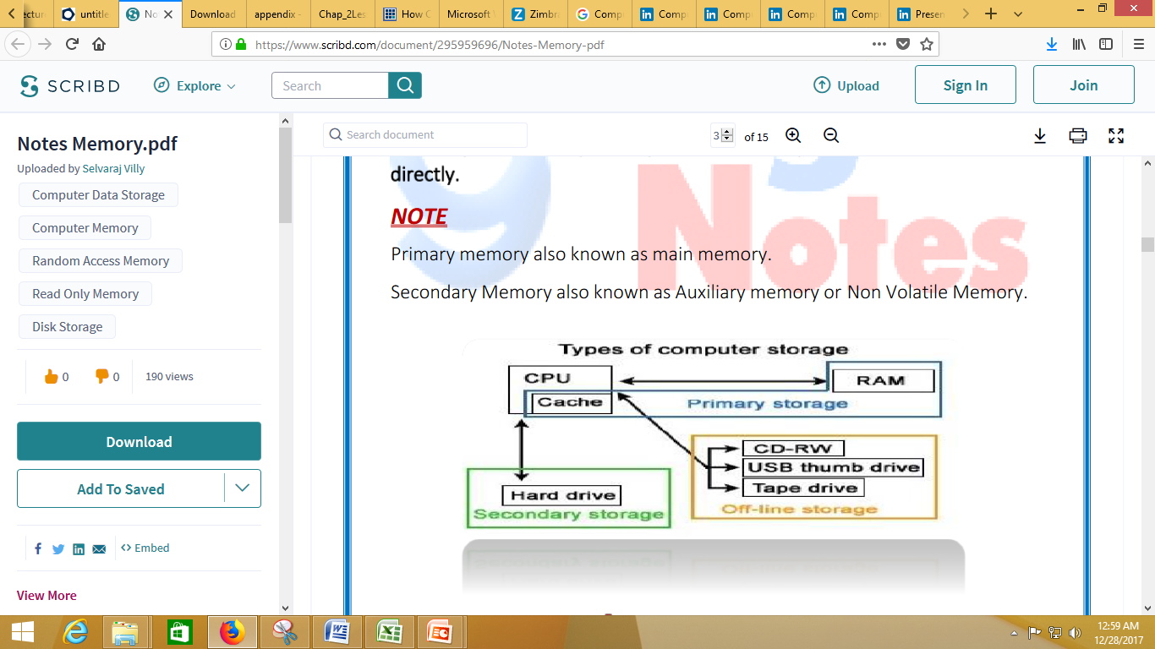

Slide 8
RAM Memory Technology
SIMM (Single In-line Memory Modules) SIMMs are used to store a single row of DRAM, EDO or BEDO chips where the module is soldered onto a PCB. One SIMM can contain several chips. When you add more memory to a computer, most likely you are adding a SIMM.
The first SIMMs transferred 8 bits of data at a time and contained 30 pins. When CPU's began to read 32-bit chunks, a wider SIMM was developed and contained 72 pins. 72 pin SIMMS are 3/4" longer than 30 pin SIMMs and have a notch in the lower middle of the PCB. 72 pin SIMMs install at a slight angle.
DIMM (Dual In-line Memory Modules) DIMMs allow the ability to have two rows of DRAM, EDO or BEDO chips. They are able to contain twice as much memory on the same size circuit board. DIMMs contain 168 pins and transfer data in 64 bit chunks. DIMMs install straight up and down and have two notches on the bottom of the PCB.

Slide 9
RAM Memory Technology
SODIMM (Small Outline DIMM) SO DIMMs are commonly used in notebooks and are smaller than normal DIMMs. There are two types of SO DIMMs. Either 72 pins and a transfer rate of 32 bits or 144 pins with a transfer rate of 64 bits.
RIMM((Rambus In-line Memory Modules )
RDRAM – RIMM
Rambus, Inc, in conjunction with Intel has created new technology, Direct RDRAM, to increase the access speed for memory. RIMMs appeared on motherboards sometime during 1999. The in-line memory modules are called RIMMs. They have 184 pins and provide 1.6 GB per second of peak bandwidth in 16 bit chunks. As chip speed gets faster, so does the access to memory and the amount of heat produced. An aluminum sheath, called a heat spreader, covers the module to protect the chips from overheating.

Slide 10
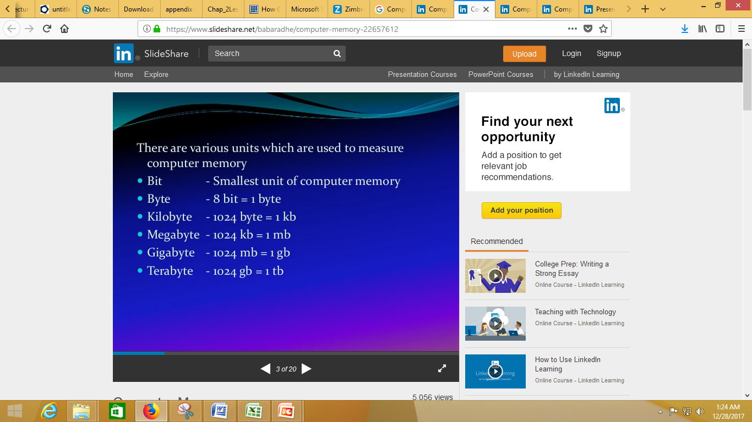

Slide 11
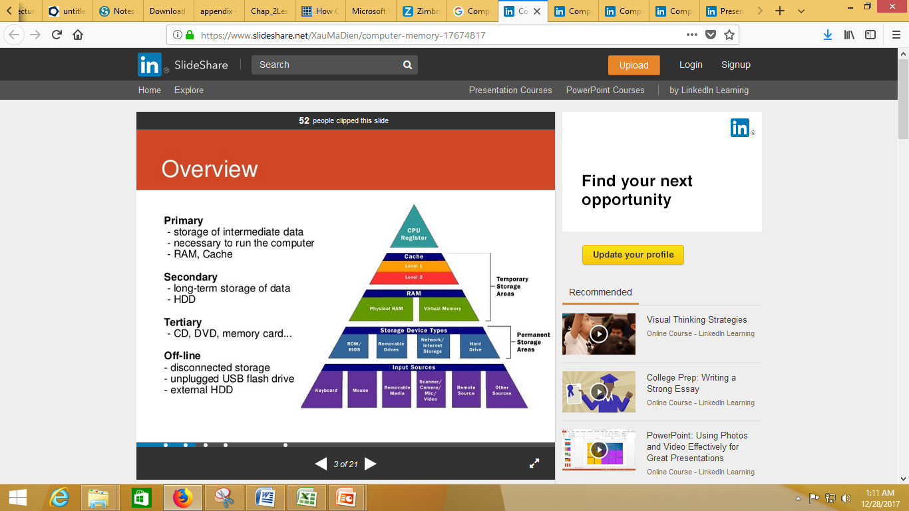

Slide 12
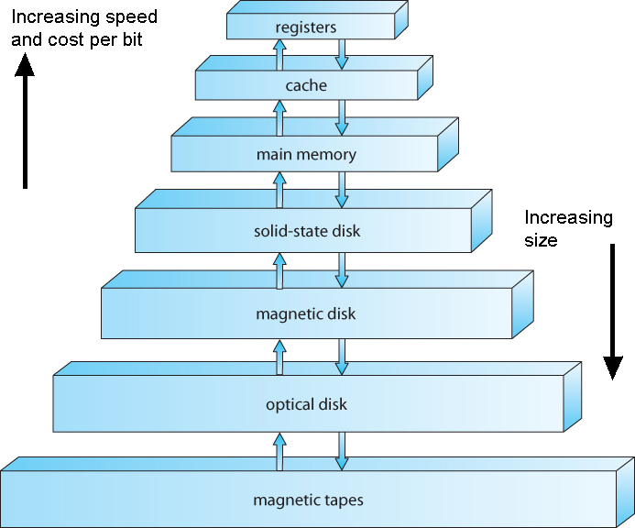

Slide 13
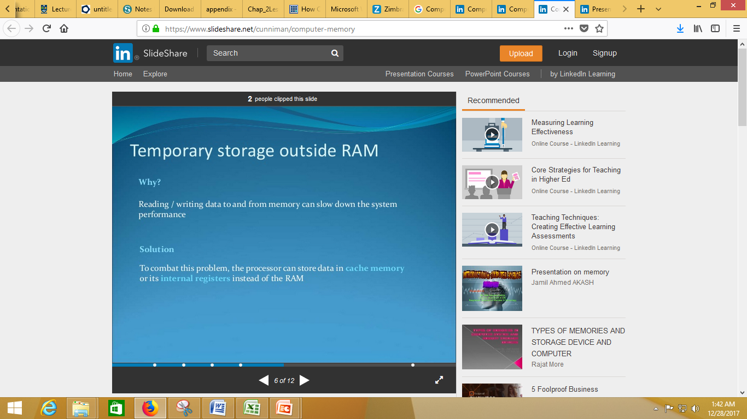

Slide 14
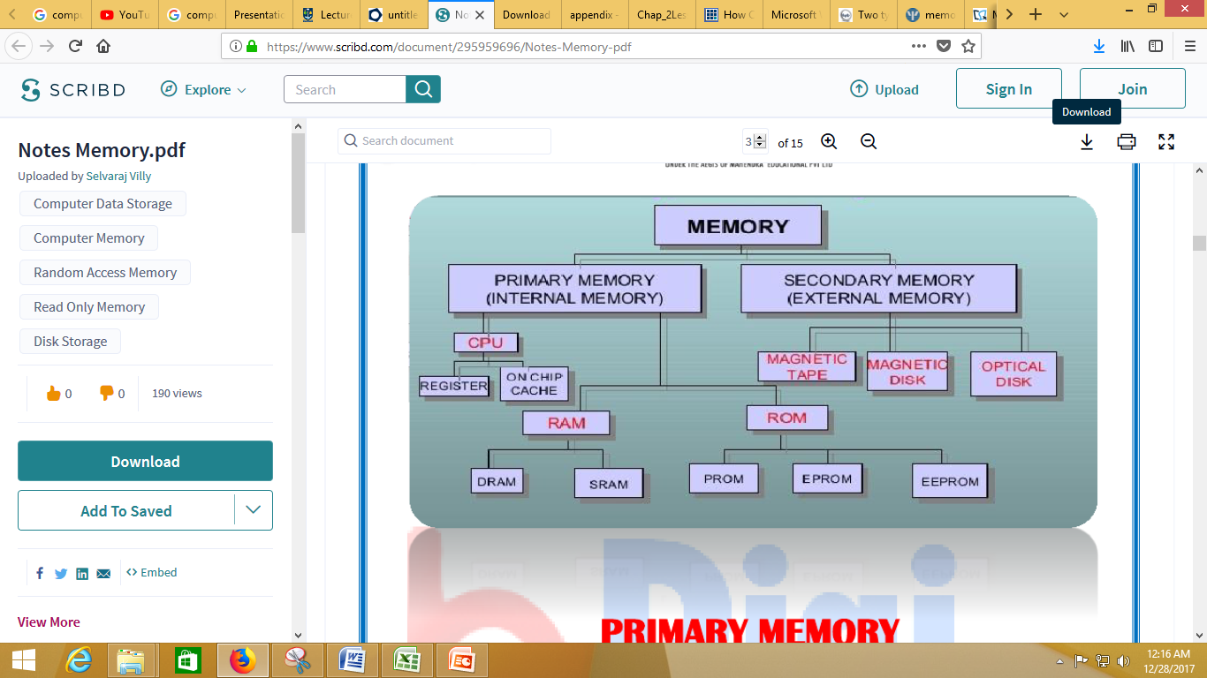

Slide 15
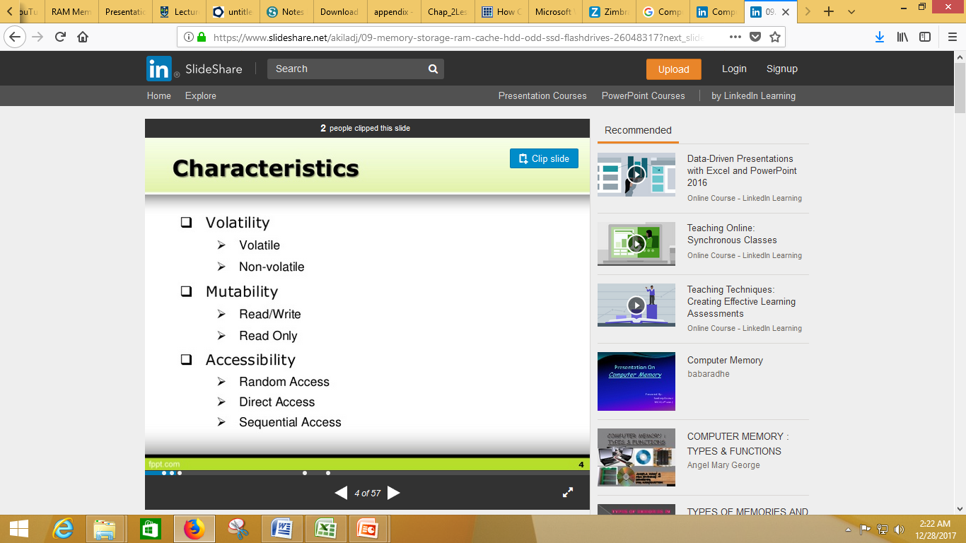

Slide 16
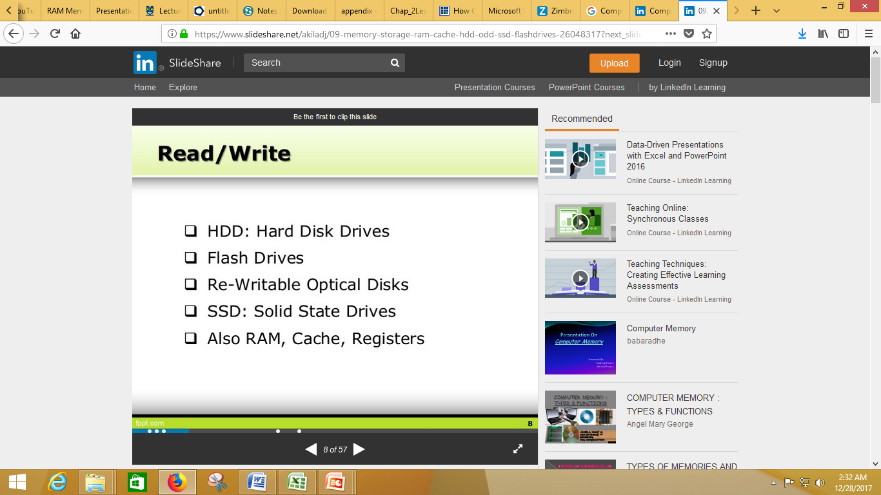

Slide 17
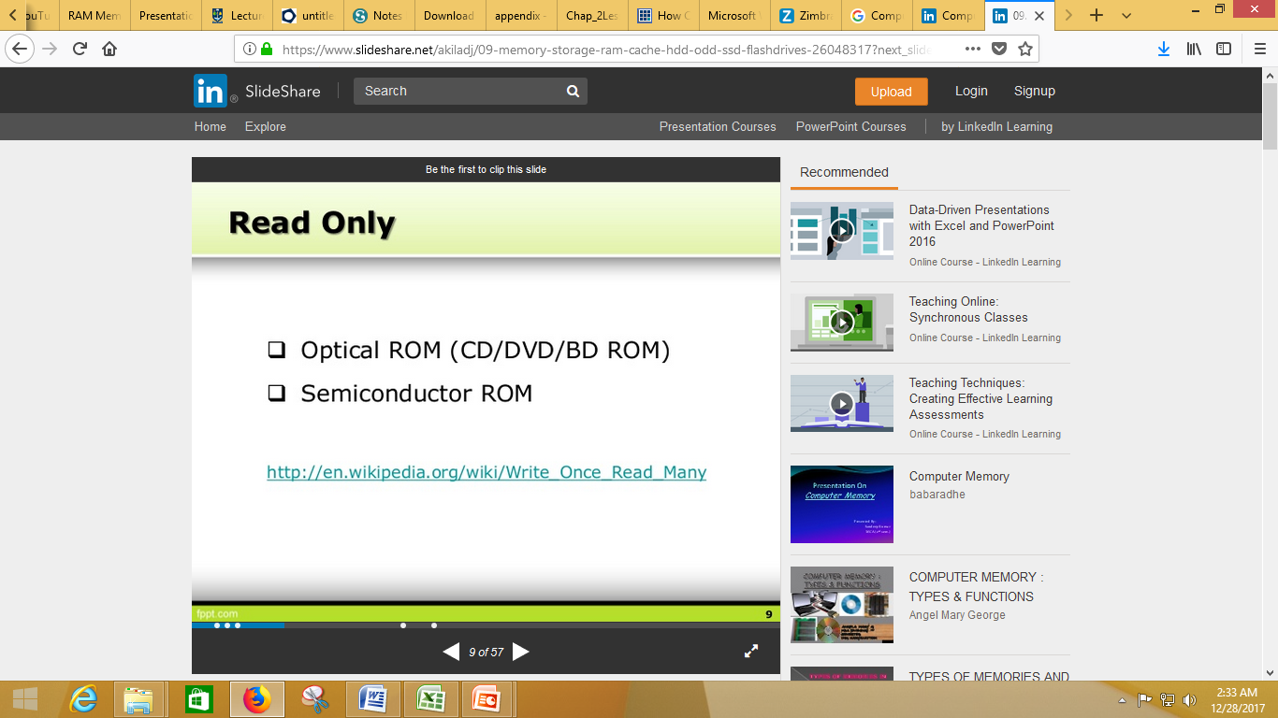

Slide 18
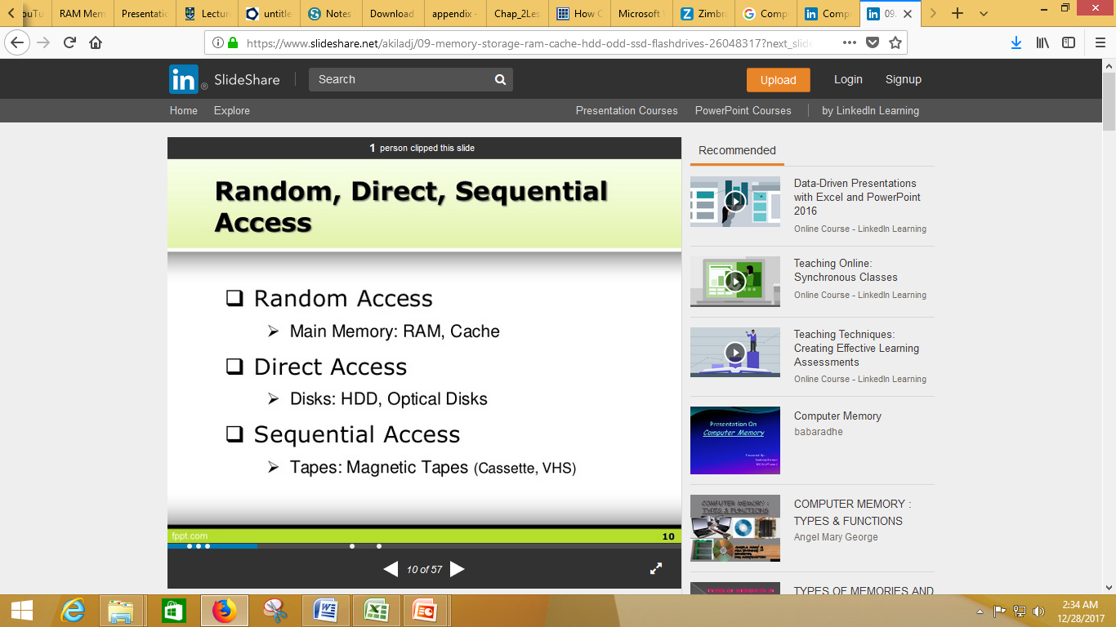
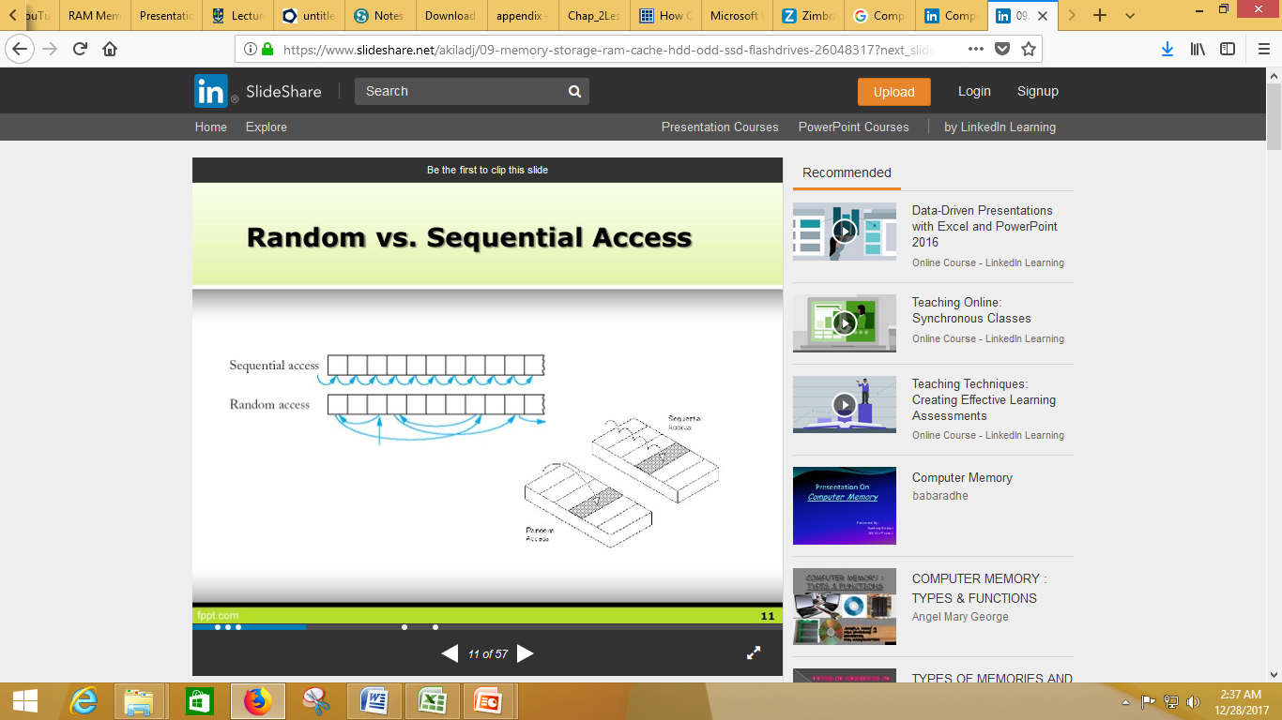

Slide 19
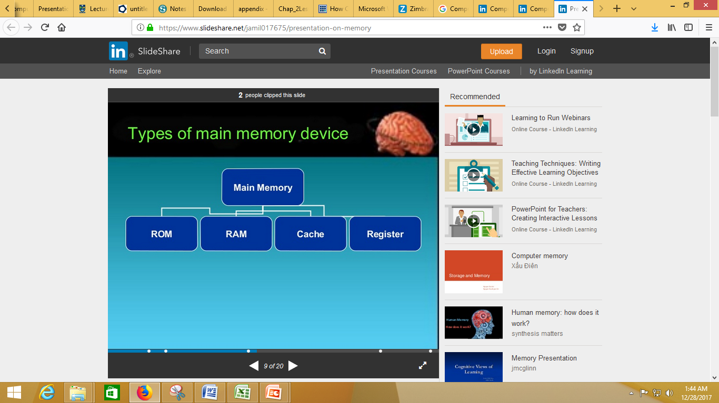

Slide 20
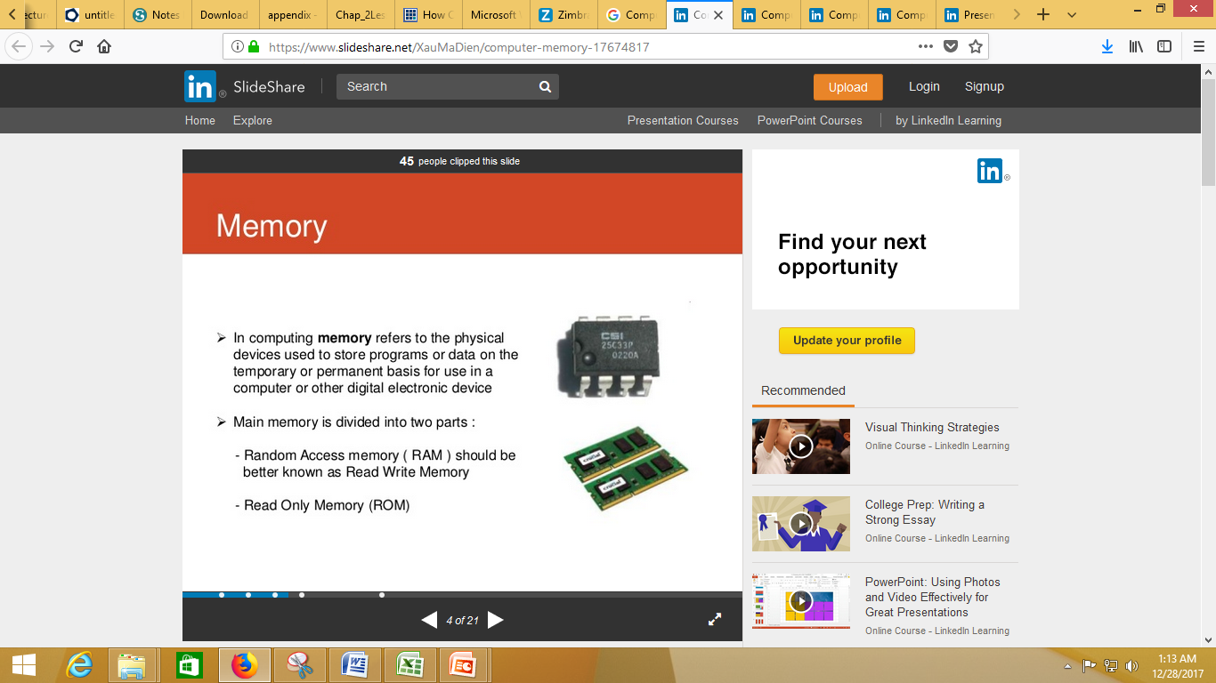

Slide 21
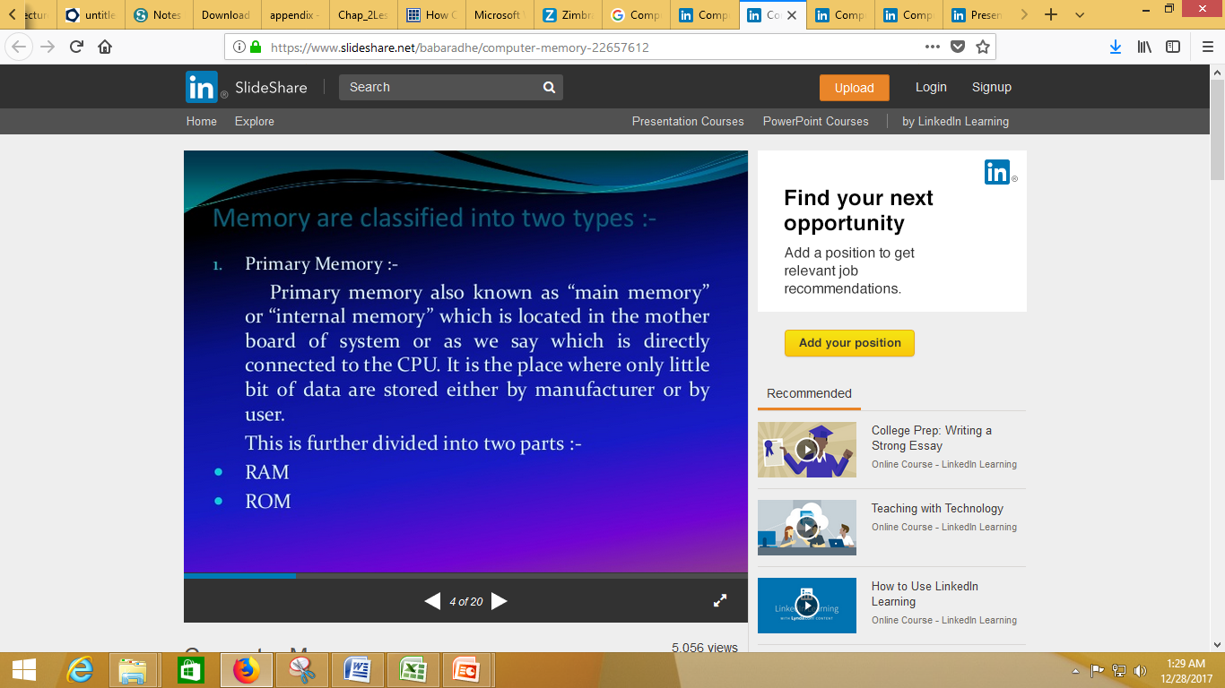

Slide 22
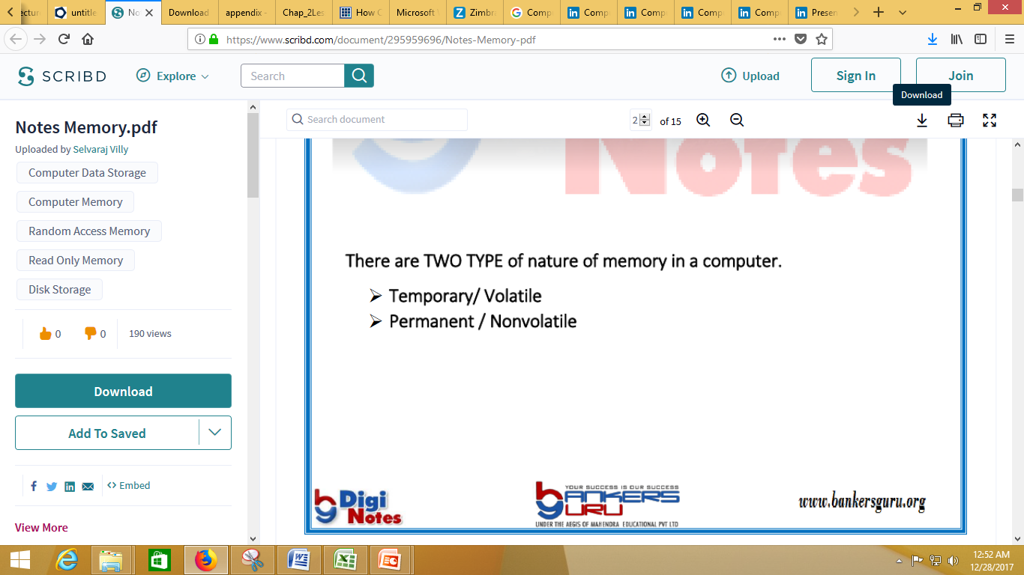
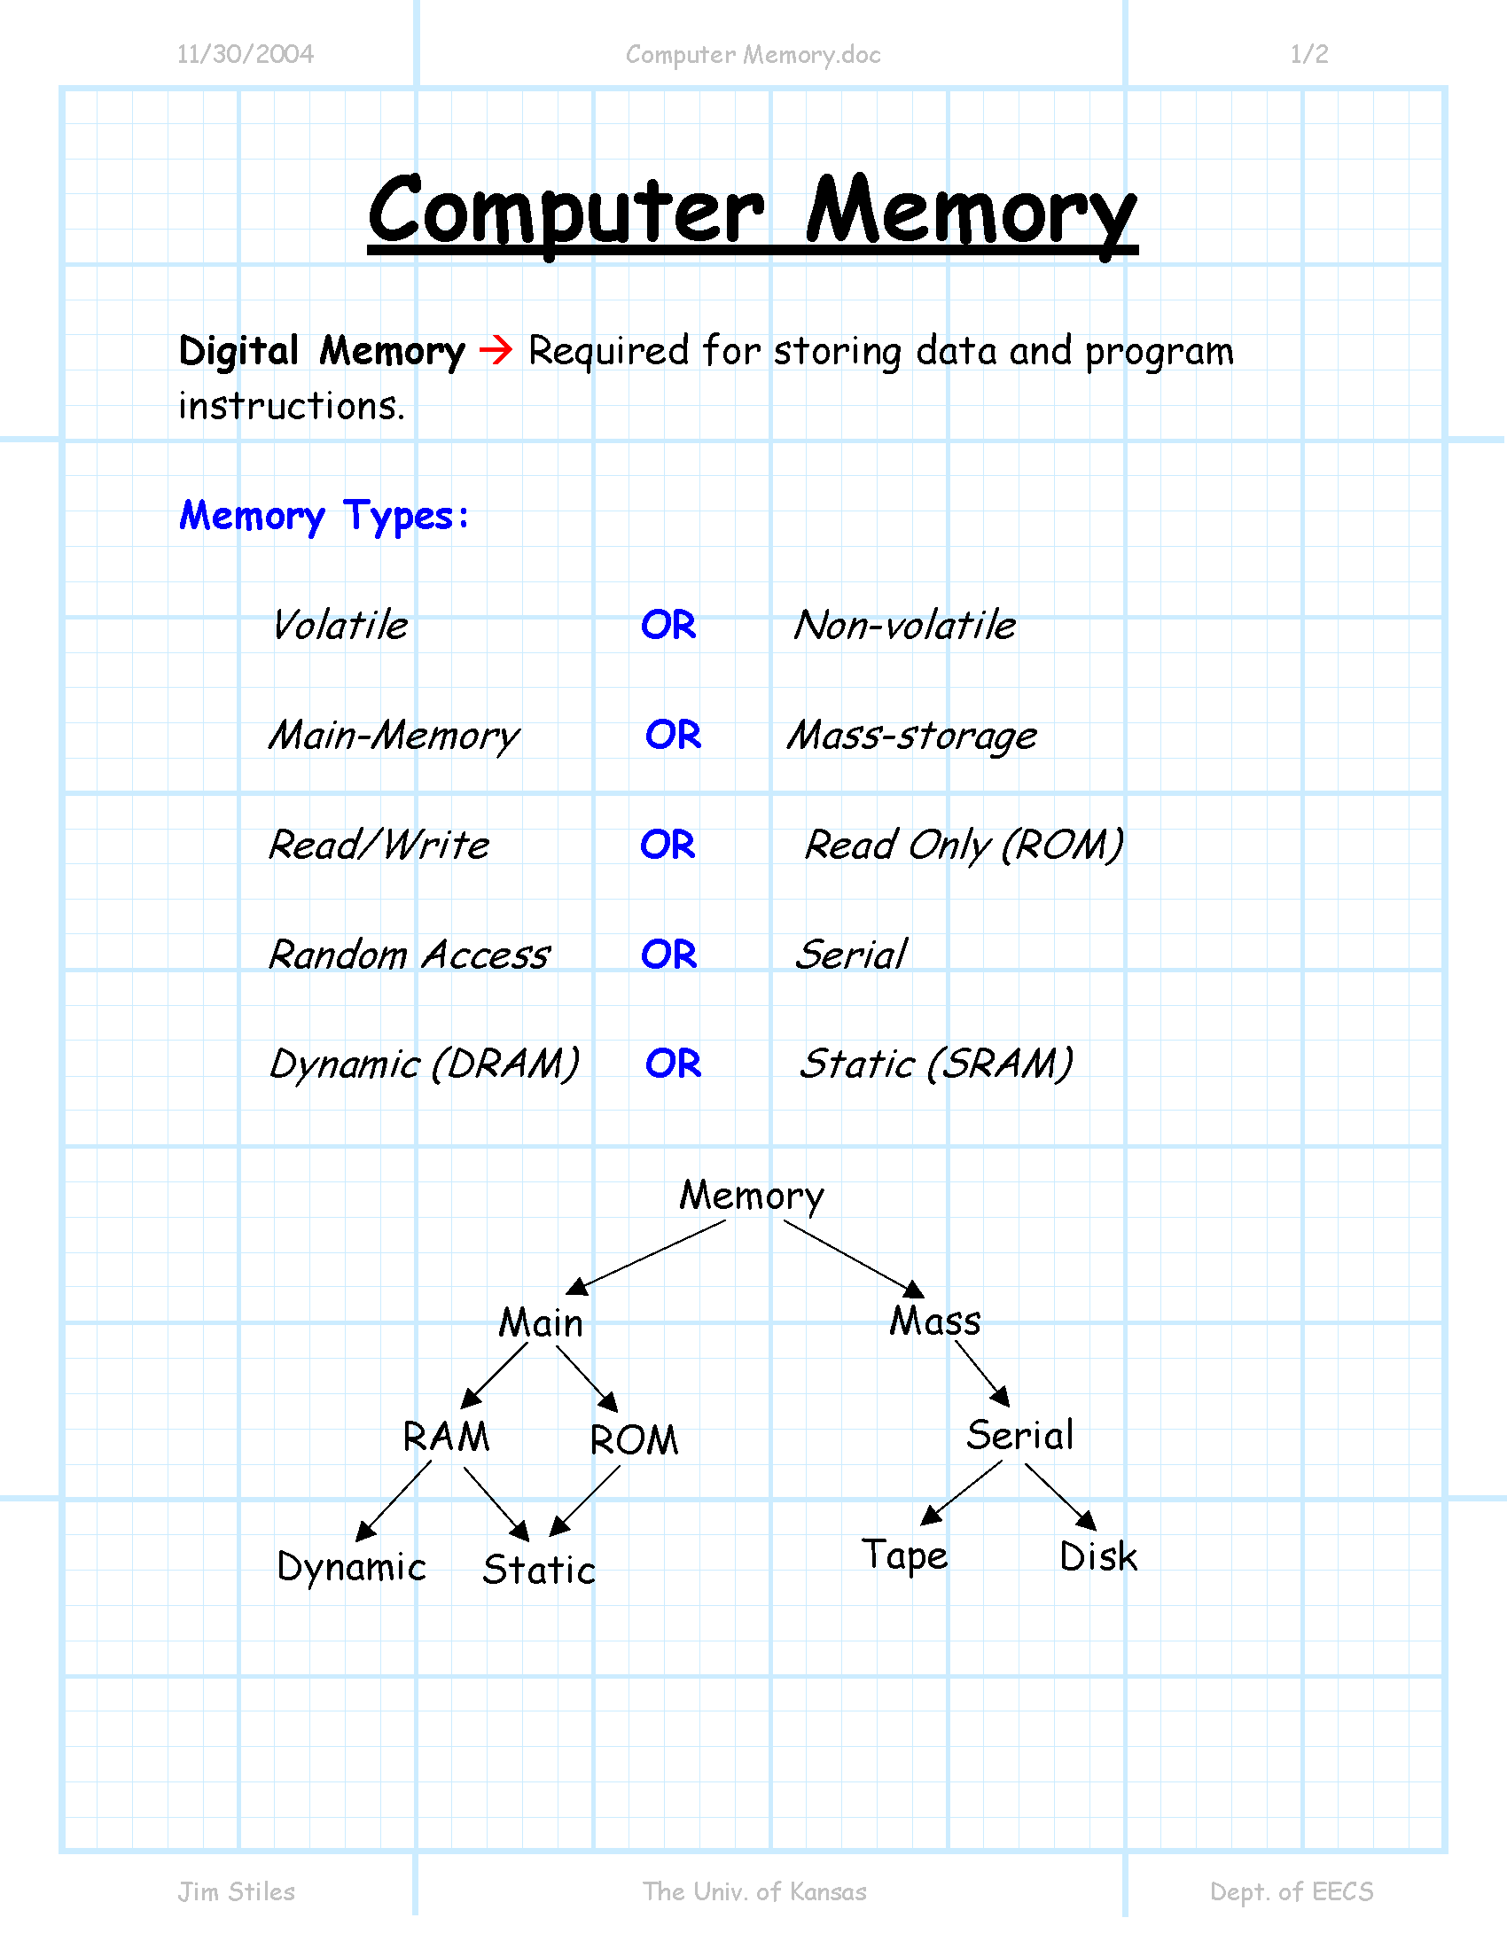

Slide 23
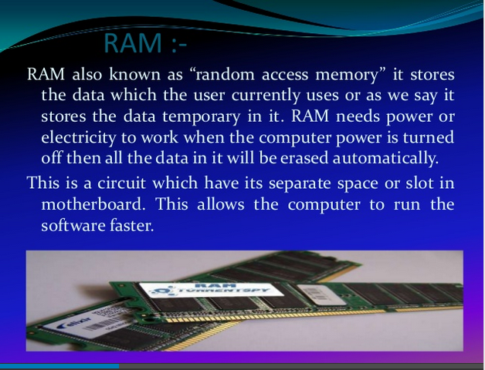

Slide 24
RAM Speed depends on
Memory RAM Speed –
Access Time,
Megahertz (MHz),
Bytes Per Second
Prior to SDRAM, speed was expressed in terms of nanoseconds (ns). This measured the amount of time it takes the module to deliver a data request. Therefore, the lower the nanosecond speed, the faster.
SDRAM speed is measured in megahertz (MHz). Speed markings on the memory chips may still specific nanoseconds, but in this case in represents the number of nanoseconds between clock cycles.

Slide 25
RAM Speed
To calculate bytes per second you need to know the Bus Width and Bus Speed of your PC. The first thing to remember is 8-bits = 1 byte. If you have a 64-bit bus, than 8 bytes of information can be transferred at one time. (64 / 8 bits = 8 bytes)
If your bus speed is 100Mhz (100 million clock cycles per second) and the bus width is 1 byte wide, the speed is 100 MB's per second. With a 64-bit width, the speed is 800 MBs per second (64 / 8 * 100,000,000)
Rambus modules are measured in megabytes per second. Rambus modules are either 400 or 300Mhz. Because they send two pieces of information every clock cycle, you get 800 or 600Mhz. They have a 16-bit bus width or 2 bytes (16/8). The 400Mhz module speed is 1600MB a second or 1.6GB a second. (400,000,000 * 2) * 2. The 300Mhz module provides 1.2GBs a second.

Slide 26
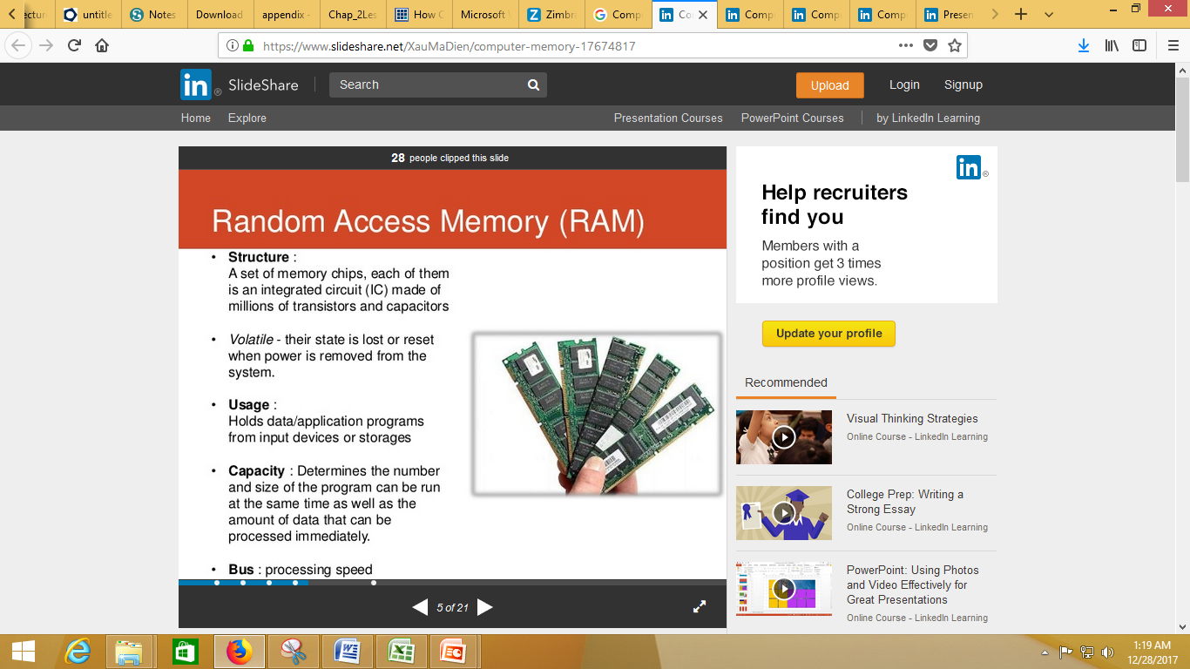

Slide 27


Slide 28
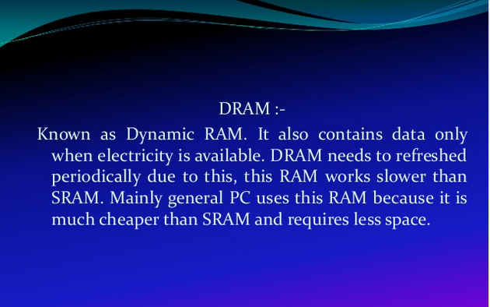

Slide 29
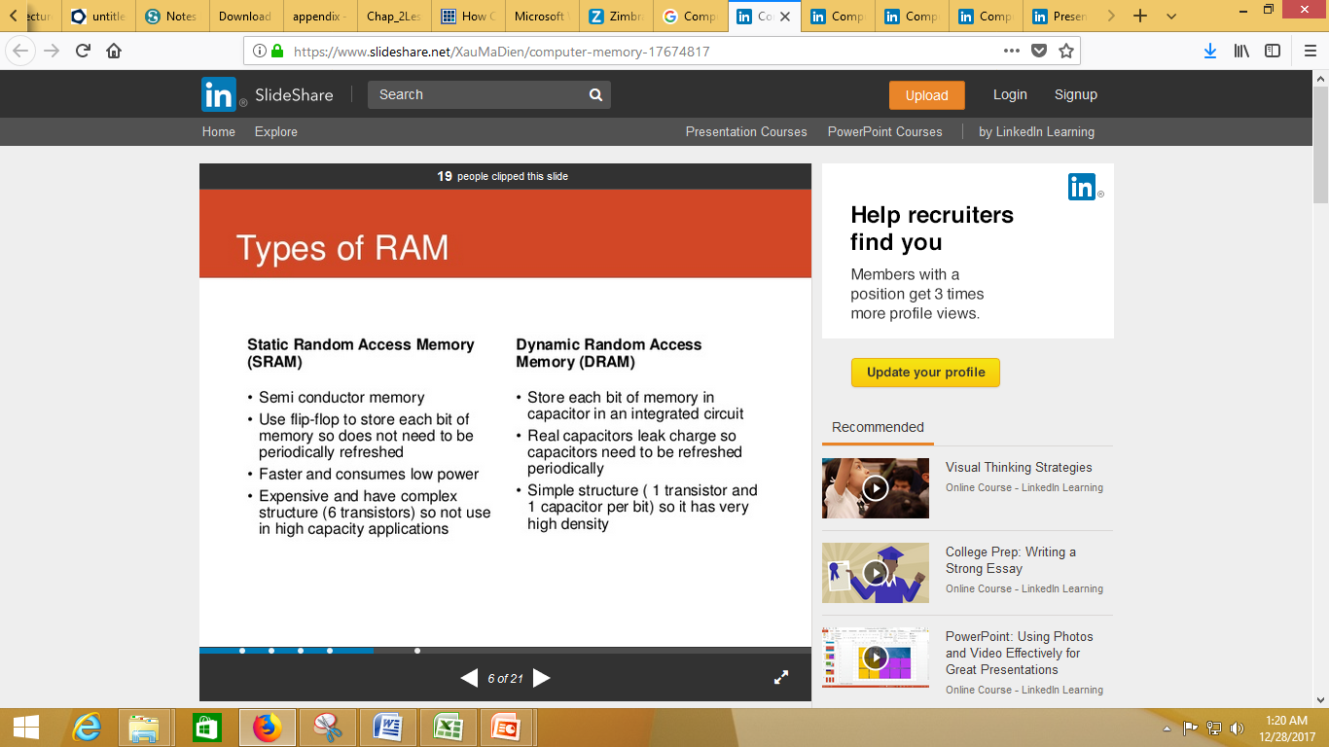

Slide 30
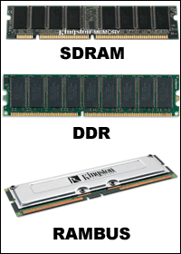
Other types of RAM

Slide 31
Other types of RAM
There are main types of RAM: SDRAM, DDR and Rambus DRAM.
SDRAM (Synchronous DRAM)
Almost all systems used to ship with 3.3 volt, 168-pin SDRAM DIMMs. SDRAM is not an extension of older EDO DRAM but a new type of DRAM altogether. SDRAM started out running at 66 MHz, while older fast page mode DRAM and EDO max out at 50 MHz. SDRAM is able to scale to 133 MHz (PC133) officially, and unofficially up to 180MHz or higher. As processors get faster, new generations of memory such as DDR and RDRAM are required to get proper performance.
DDR (Double Data Rate SDRAM)
DDR basically doubles the rate of data transfer of standard SDRAM by transferring data on the up and down tick of a clock cycle. DDR memory operating at 333MHz actually operates at 166MHz * 2 (aka PC333 / PC2700) or 133MHz*2 (PC266 / PC2100). DDR is a 2.5 volt technology that uses 184 pins in its DIMMs. It is incompatible with SDRAM physically, but uses a similar parallel bus, making it easier to implement than RDRAM, which is a different technology.

Slide 32
Other types of RAM
Rambus DRAM (RDRAM) Despite it's higher price, Intel has given RDRAM it's blessing for the consumer market, and it will be the sole choice of memory for Intel's Pentium 4. RDRAM is a serial memory technology that arrived in three flavors, PC600, PC700, and PC800. PC800 RDRAM has double the maximum throughput of old PC100 SDRAM, but a higher latency. RDRAM designs with multiple channels, such as those in Pentium 4 motherboards, are currently at the top of the heap in memory throughput, especially when paired with PC1066 RDRAM memory.

Slide 33
Other types of RAM
DIMMs vs. RIMMs DRAM comes in two major form factors: DIMMs and RIMMS.
DIMMs are 64-bit components, but if used in a motherboard with a dual-channel configuration (like with an Nvidia nForce chipset) you must pair them to get maximum performance. So far there aren't many DDR chipset that use dual-channels. Typically, if you want to add 512 MB of DIMM memory to your machine, you just pop in a 512 MB DIMM if you've got an available slot. DIMMs for SDRAM and DDR are different, and not physically compatible. SDRAM DIMMs have 168-pins and run at 3.3 volts, while DDR DIMMs have 184-pins and run at 2.5 volts.
RIMMs use only a 16-bit interface but run at higher speeds than DDR. To get maximum performance, Intel RDRAM chipsets require the use of RIMMs in pairs over a dual-channel 32-bit interface. You have to plan more when upgrading and purchasing RDRAM.

Slide 34
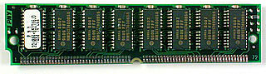
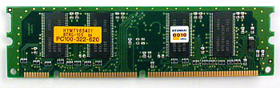
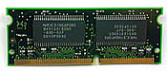
Other types of RAM
From the top: SIMM, DIMM and SODIMM memory modules

Slide 35
Memory Terminology
Memory Speed
CAS Latency SDRAM comes with latency ratings or "CAS (Column Address Strobe) latency" ratings.
Understanding Cache
Memory Redundancy

Slide 36
Memory Terminology
Cache really a five or six level structure:
The first two levels of memory are contained in the processor itself, consisting of the processor's small internal memory, or registers, and L1 cache, which is the first level of cache, usually contained in the processor.
The third level of memory is the L2 cache, usually contained on the motherboard.
The fourth level, is being referred to as L3 cache. This cache used to be the L2 cache on the motherboard, but now that some processors include L1 and L2 cache on the chip, it becomes L3 cache. Usually, it runs slower than the processor, but faster than main memory.
The fifth level (or fourth if you have no "L3 cache") of memory is the main memory itself.
The sixth level is a piece of the hard disk used by the Operating System, usually called virtual memory. Most operating systems use this when they run out of main memory, but some use it in other ways as well.

Slide 37
Memory Terminology
Memory Redundancy
One important aspect to consider in memory is what level of redundancy you want. There are a few different levels of redundancy available in memory. Depending on your motherboard, it may support all or some of these types of memory:
The cheapest and most prevalent level of redundancy is non-parity memory. When you have non-parity memory in your machine and it encounters a memory error, the operating system will have no way of knowing and will most likely crash, but could corrupt data as well with no way of telling the OS. This is the most common type of memory, and unless specified, that's what you're getting. It works fine for most applications
The second level of redundancy is parity memory (also called true parity). Parity memory has extra chips that act as parity chips. Thus, the chip will be able to detect when a memory error has occurred and signal the operating system.

Slide 38
Memory Terminology
c. The third level of redundancy is ECC (Error Checking and Correcting). This requires even more logic and is usually more expensive. Not only does it detect memory errors, but it also corrects 1-bit ECC errors. If you have a 2-bit error, you will still have some problems. Some motherboards enable you to have ECC memory.

Slide 39
Memory Terminology
Older memory types Fast Page Mode DRAM Fast Page Mode DRAM is plain old DRAM as we once knew it. The problem with standard DRAM was that it maxes out at about 50 MHz.
EDO DRAM EDO DRAM gave people up to 5% system performance increase over DRAM. EDO DRAM is like FPM DRAM with some cache built into the chip. Like FPM DRAM, EDO DRAM maxes out at about 50 MHz. Early on, some system makers claimed that if you used EDO DRAM you didn't need L2 cache in your computer to get decent performance. They were wrong. It turns out that EDO DRAM works along with L2 cache to make things even faster, but if you lose the L2 cache, you lose a lot of speed.

Slide 40
Other types of RAM
FPM (Fast Page Mode)
At one time, this was the most common and was often just referred to as DRAM. It offered faster access to data located within the same row.
EDO (Extended Data Out)
Newer than DRAM (1995) and requires only one CPU wait state. You can gain a 10 to 15% improvement in performance with EDO memory. BEDO (Burst Extended Data Out)
A step up from the EDO chips. It requires zero wait states and provides at least another 13 percent increase in performance.
SDRAM (Static DRAM)
Introduced in late 1996, retains memory and does not require refreshing. It synchronizes itself with the timing of the CPU. It also takes advantage of interleaving and burst mode functions. SDRAM is faster and more expensive than DRAM. It comes in speeds of 66, 100, 133, 200, and 266MHz.

Slide 41
Other types of RAM
DDR SDRAM (Double Data Rate Synchronous DRAM)
Allows transactions on both the rising and falling edges of the clock cycle. It has a bus clock speed of 100MHz and will yield an effective data transfer rate of 200MHz.
Direct Rambus
Extraordinarily fast. By using doubled clocked provides a transfer rate up to 1.6GBs yielding a 800MHz speed over a narrow 16 bit bus. Cache RAM
This is where SRAM is used for storing information required by the CPU. It is in kilobyte sizes of 128KB, 256KB, etc.
VRAM (Video RAM)
VRAM is a video version of FPM and is most often used in video accelerator cards. Because it has two ports, It provides the extra benefit over DRAM of being able to execute simultaneous read/write operations at the same time. One channel is used to refresh the screen and the other manages image changes. VRAM tends to be more expensive.

Slide 42
Other types of RAM
Flash Memory This is a solid-state, nonvolatile, rewritable memory that functions like RAM and a hard disk combined. If power is lost, all data remains in memory. Because of its high speed, durability, and low voltage requirements, it is ideal for digital cameras, cell phones, printers, handheld computers, pagers and audio recorders. Shadow RAM When your computer starts up (boots), minimal instructions for performing the startup procedures and video controls are stored in ROM (Read Only Memory) in what is commonly called BIOS. ROM executes slowly. Shadow RAM allows for the capability of moving selected parts of the BIOS code from ROM to the faster RAM memory.

Slide 43
Determining your Computer RAM Type
Currently the cost for adding additional memory is very low. Installation of memory is also fairly simple. It does not require any reconfiguration. The difficult part is determining what type of memory you need.
Type | Socket | Amount
More information on memory determination... Looking Inside | Check the Manual | Identification

Slide 44
Determining your Computer RAM Type
1. Type
FPM – Fast Page Mode- If you have a 486, you probably have FPM
EDO – Extended Data Out - If you have an early Pentium system, you probably have EDO
SDRAM - If you have a Pentium or Celeron system purchased in 1999, you probably have SDRAM
2. Sockets
Memory modules plug into a socket on the motherboard. There are three socket types.
SIMM – 30 pin – 3 inches in length
SIMM – 72 pin – 4 inches in length
DIMM – 168 pin – 5 inches in length
Most older 486 machines will use 30 pin modules. Later model 486 and Pentium machines will probably use 72 pin modules. More recent Pentium machines may have 168 pin.

Slide 45
Determining your Computer RAM Type
Amount
Memory sizes increase by the power of 2. This results in
sizes of 1, 2, 4, 8, 16, 32, 64, 128, 256 MBs.
On some older 486 machines, one memory module can be
added at a time.
On most Pentium machines, modules must be added in
pairs. Each pair must be of the same size. SDRAM modules
can be added one at a time.
For example, if you have 8 MBs of memory on a Pentium, you have two 4 MB modules. To increase to 16 MBs, you need to add two more 4 MB modules. To increase to 24 MBs, you need to add two 8 MB modules.

Slide 46
Determining your Computer RAM Type
Looking Inside
Now that you know the parameters, how do you determine which type you need? Looking inside the computer will not provide all of the information. It will confirm how many modules you currently have. You can also confirm the type and quantity of open sockets. If you only have four sockets and each socket contains a module, you will have to replace some of the existing memory modules.
Check the Manual
The other place to find the correct information is your owner’s manual. The manufacturer should have listed the type of memory required. You will need to determine the parity and speed.

Slide 47
Determining your Computer RAM Type
Identification
Now that you have the necessary information, you find an ad for memory and still you may not be able to determine which modules you need. Why? Because the computer industry thrives on confusion and abbreviations. Here’s how to interpret the coding scheme.
30 pin modules
For 30 pin modules you will see something like
1 x 9-60 ,4 x 9-70 , 4 x 8-70
The first number is the size in MB’s. In our example this would be 1MB or 4MB.
The second number represents parity. The value 9 represents parity and 8 represents non-parity. (Of course that makes a lot of sense!) The 9 or 8 also identifies that it is a 30 pin module.
The third value represents the speed.

Slide 48
Determining your Computer RAM Type
72 pin modules
For 72 pin modules you will see something like
1 x 32-60
2 x 32-70
4 x 36-60
8 x 36-70
Just like the 30 pin modules, the first value represents the size, EXCEPT it only represents ¼ of the total memory size. Don’t ask why, just accept it. So the value of 4 represents a 16 MB (4 x 4) module. A value of 8 represents a 32 MB (4 x 8) module.
The second value, again just like the 30 pin, represents parity and the number of pins. 36 is used for parity and 32 for non-parity. You aren’t asking why again, are you?
The third value represents the speed, the same as the 30 pin.

Slide 49
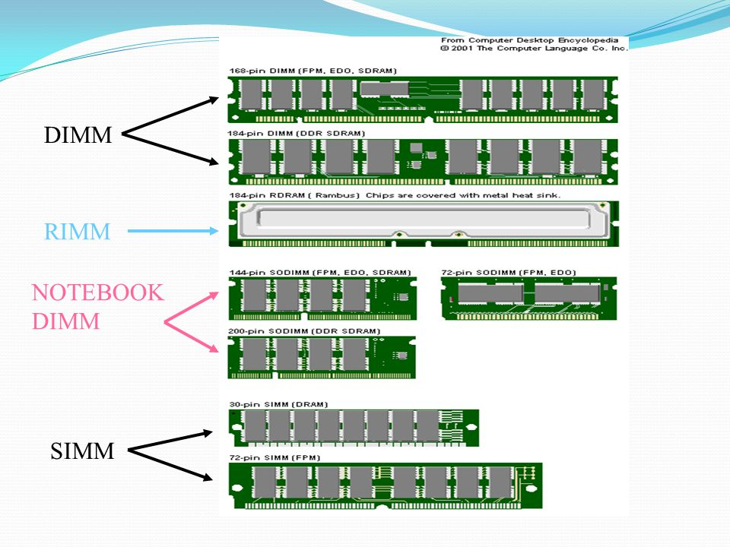
Types of RAM with Slots
SDR,DDR
240 pins—DDR3
232 pins
326 pins
Above RAM shows a typical
30-pin (8-bit) SIMM, 72-pin (32-bit) SIMM, 168-pin SDRAM DIMM, 184-pin DDR SDRAM (64-bit) DIMM,
240-pin DDR2 DIMM, 240-pin DDR3 DIMM,
and 184-pin RIMM, respectively.

Slide 50
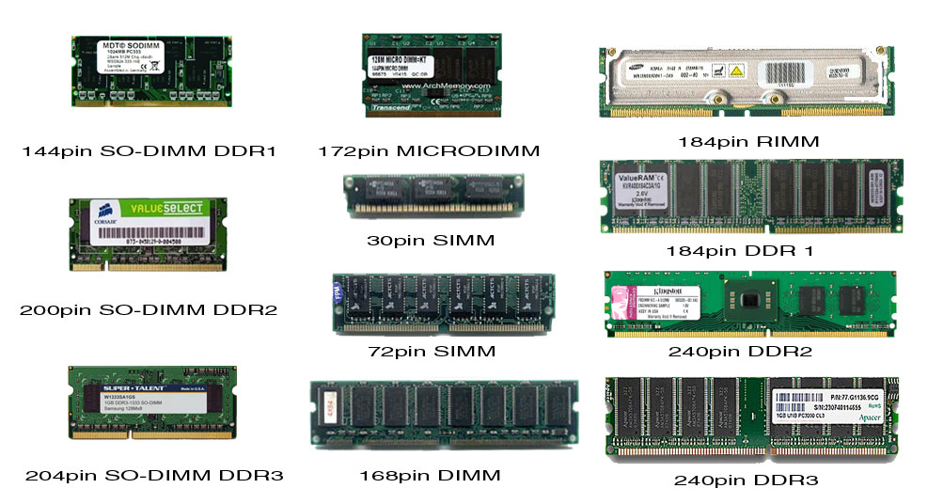
Some images of RAM

Slide 51
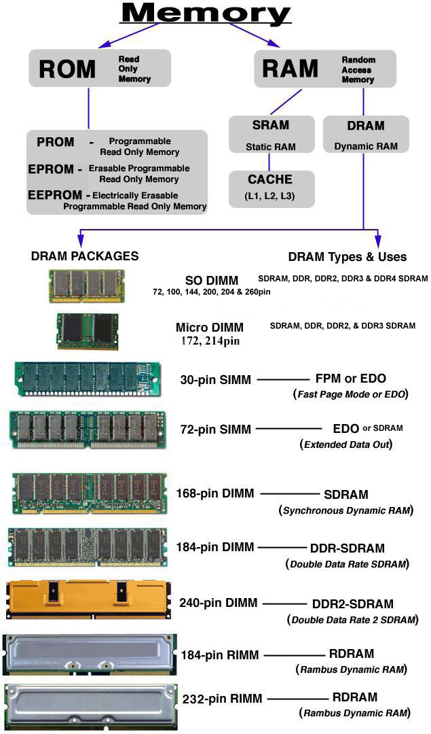

Slide 52
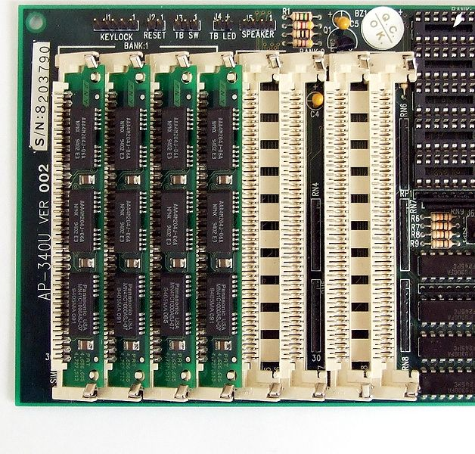

Slide 53
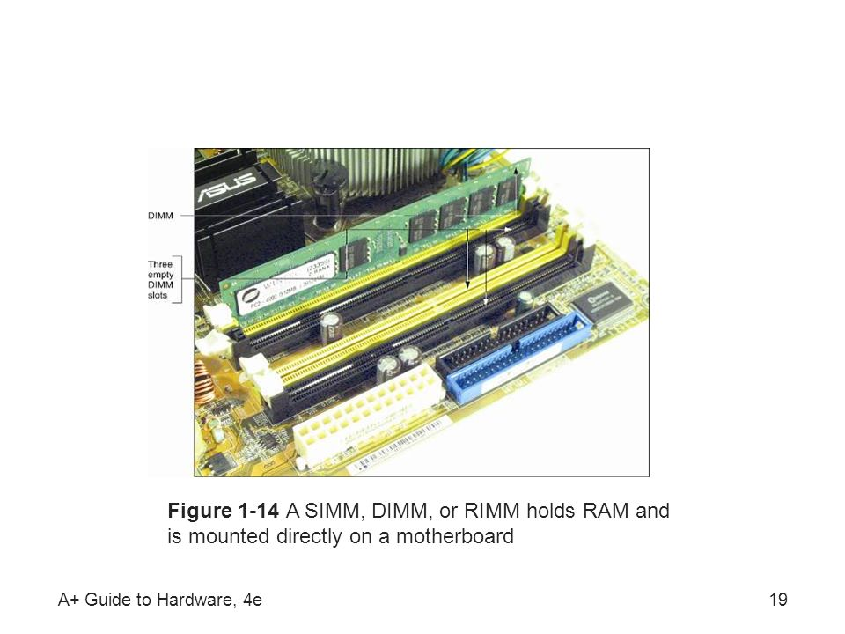

Slide 54
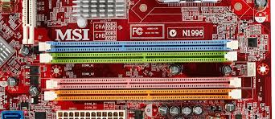

Slide 55
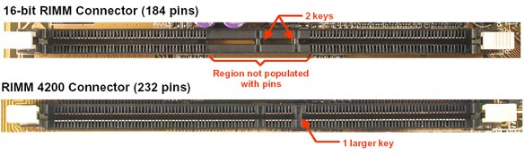

Slide 56
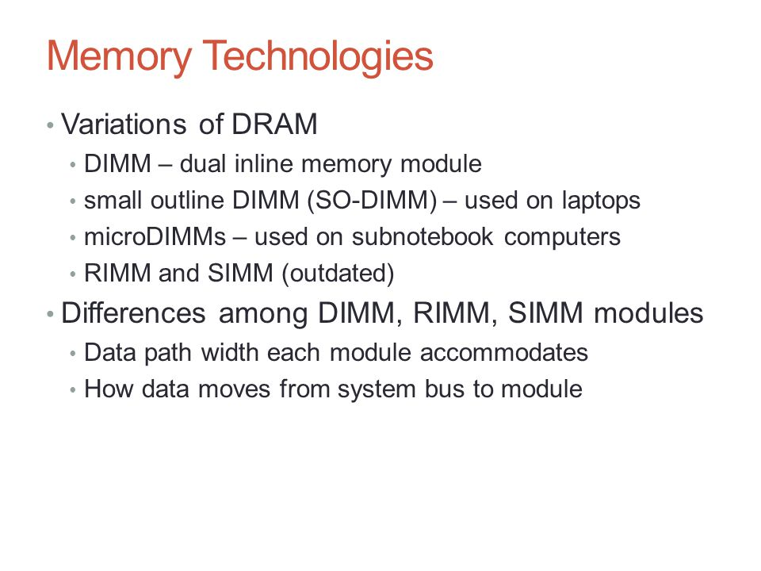

Slide 57
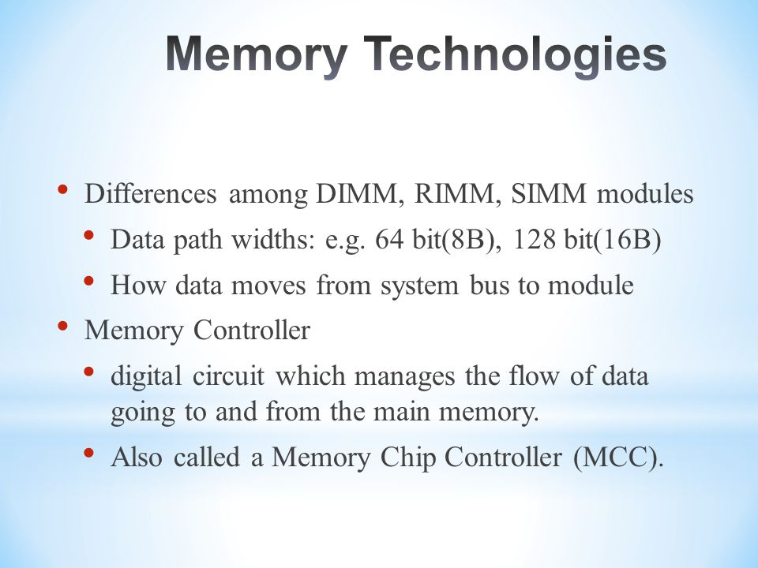

Slide 58
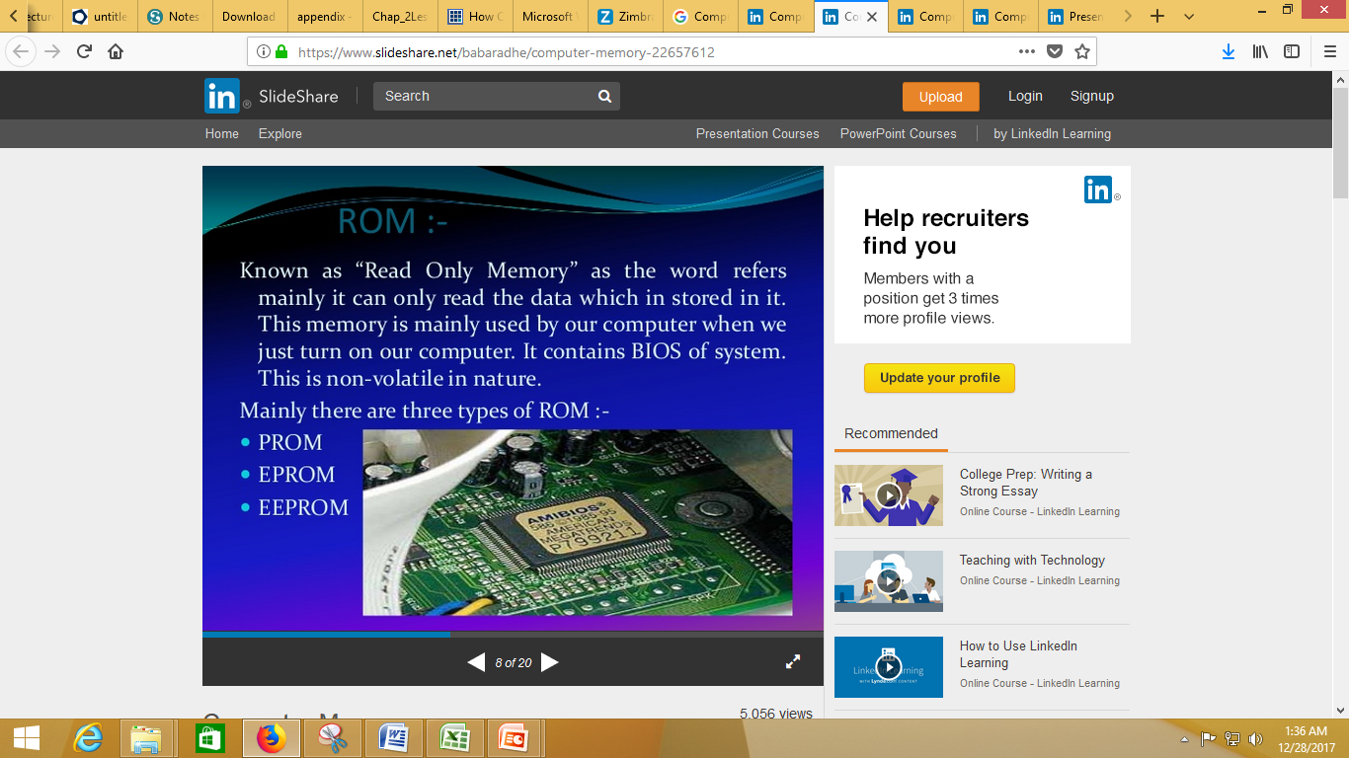

Slide 59
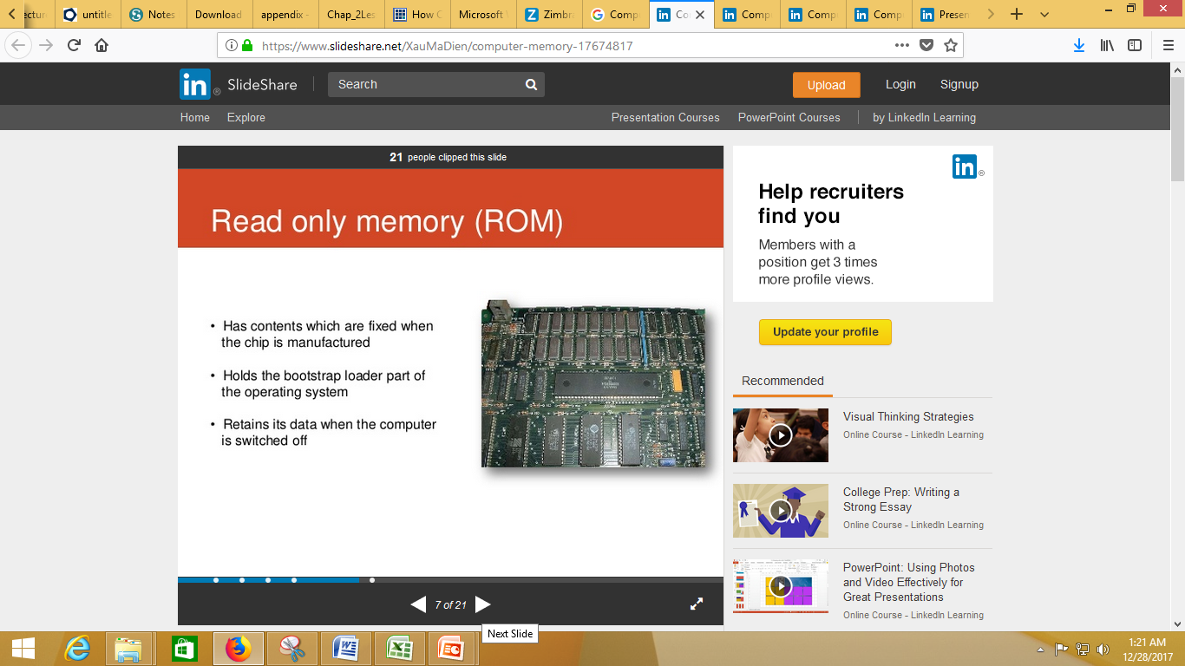

Slide 60
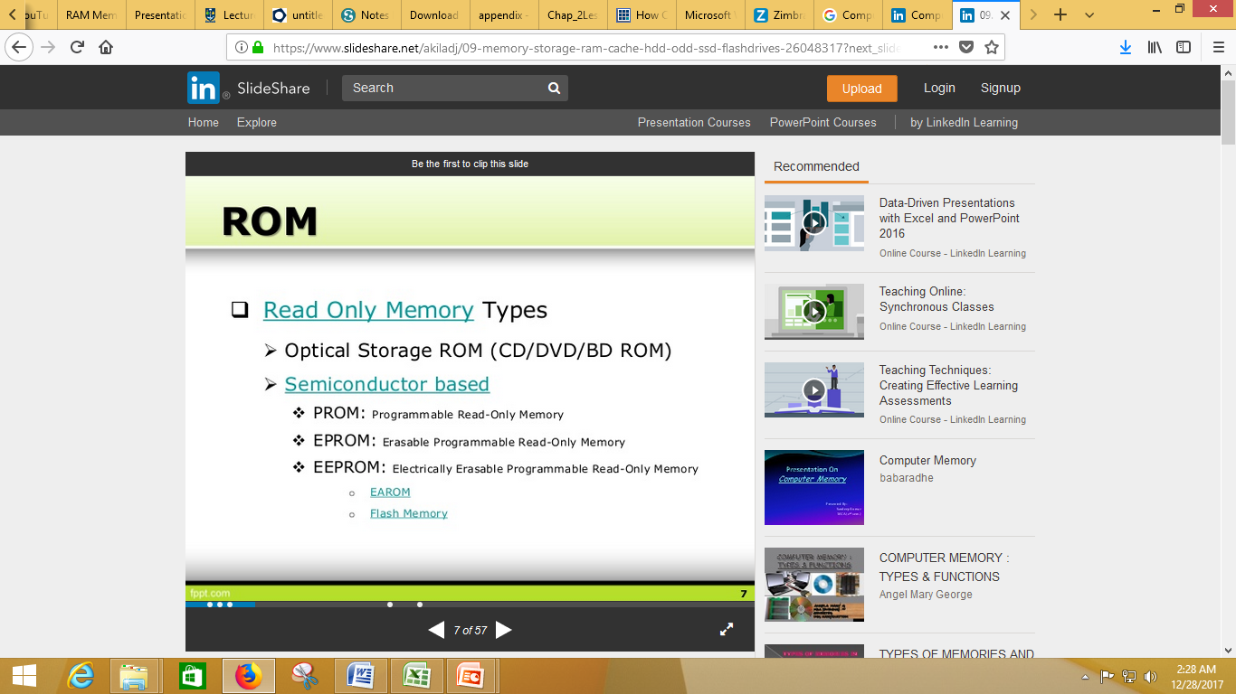

Slide 61
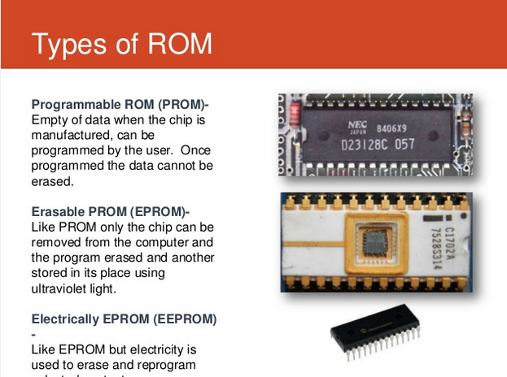

Slide 62


Slide 63


Slide 64


Slide 65
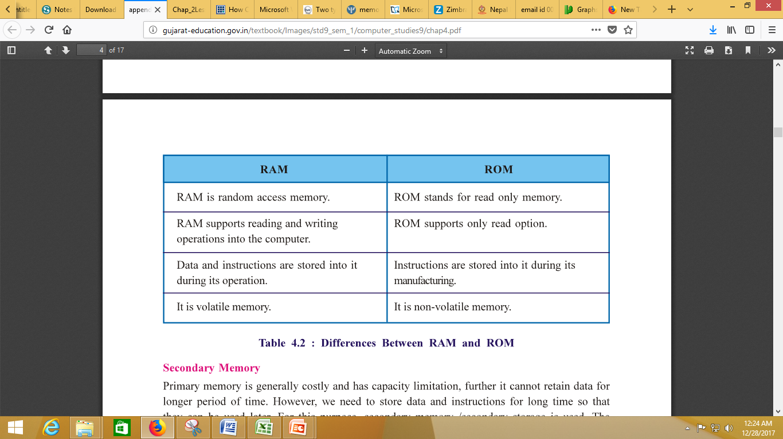

Slide 66
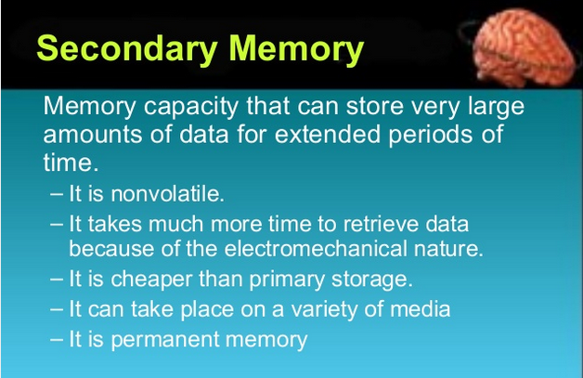

Slide 67
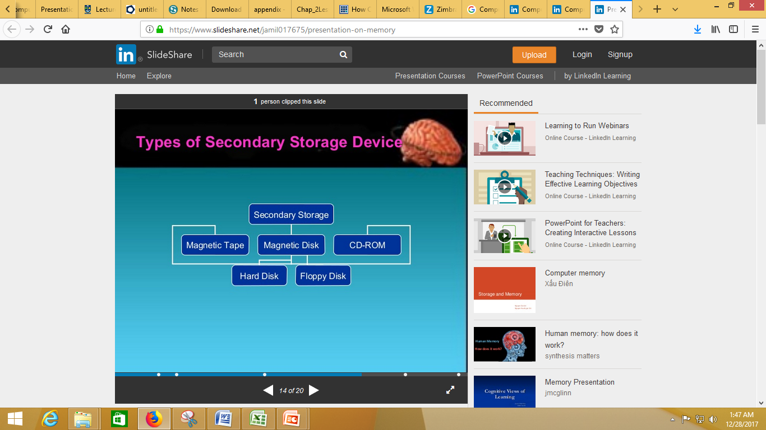

Slide 68
https://www.slideshare.net/akiladj/09-memory-storage-ram-cache-hdd-odd-ssd-flashdrives-26048317?next_slideshow=1
http://www.computermemoryupgrade.net/computer-memory-types-and-memory-technology.html
http://www.mmumullana.org/downloads/mca%20content/BCA_101%20Computer%20fundamental%20&%20Basics%20of%20C%20language.pdf
http://www.polyteknisk.dk/related_materials/9780789736970_Chapter_6.pdf

Slide 69
https://www.slideshare.net/akiladj/09-memory-storage-ram-cache-hdd-odd-ssd-flashdrives-26048317?next_slideshow=1
http://www.computermemoryupgrade.net/computer-memory-types-and-memory-technology.html
http://www.mmumullana.org/downloads/mca%20content/BCA_101%20Computer%20fundamental%20&%20Basics%20of%20C%20language.pdf
http://www.polyteknisk.dk/related_materials/9780789736970_Chapter_6.pdf

